Slide 1
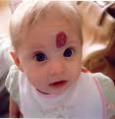
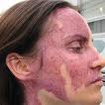
Pigmented lesions of oral mucosa

Slide 2
CONTENTS
INTRODUCTION
CLASSIFICATIONS
FOCAL MELANOTIC PIGMENTATIONS
MULTIFOCAL / DIFFUSED PIGMENTATIONS
MELANOSIS ASSOCIATED WITH SYSTEMIC / GENETIC DISEASES.
EXOGENOUS PIGMENTATIONS
BROWN HEME ASSOCIATED LESIONS.
SUMMARY
BIBLIOGRAPHY

Slide 3
INTRODUCTION
The word pigment is derived from the Latin word meaning color or coloring.
Pigmentation is a discoloration of the oral mucosa or gingiva due to the wide variety of lesions and conditions.
The hue, duration, number, color, location, distribution, size, shape of the pigmented lesion aids in the diagnosis of the disease. Hence a thorough understanding of pigmented lesions is necessary.

Slide 4
Oral and perioral pigmentation may be
-physiologic or
-pathologic in origin.
Physiologic pigmentation is typically brown in colour.
Oral pigmentation has been associated with a variety of endogenous and exogenous etiologic factors.
Endogenous pigments:
Hemosiderin ;melanin ;hemoglobin.
Exogenous pigments:
Heavy metals.

Slide 5
Endogenous Pigmentation in Oral Mucosa
Pigment Color Disease Process
Hemoglobin Blue, red or purple Varix, hemangioma, Kaposi’s
sarcoma, angiosarcoma, hereditary hemorragic telangiectasia.
Hemosiderin Brown Ecchymosis, petechiae, thrombosed varix, hemorrahgic mucocele, hemochromatosis.
Melanin Brown, black, gray Melanotic macule, nevus, melanoma.

Slide 6
Exogenous Pigmentation of Oral Mucosa
Source Color Disease process
Silver amalgam gray, black tattoo, iatrogenic trauma
Graphite gray, black tattoo, trauma
Lead, mercury, Bismuth gray ingestion of paints & medicines
Chromogenic Bacteria black, brown, green superficial colonization

Slide 7
Clinical Classification of Oral Pigmentations
Color focal diffuse multifocal
Blue/purple Varix hemangioma kaposi’s sarcoma,
Hemangioma hemorrhagic telangiectasia .
Brown Melanotic macule ecchymosis Physiologic pigment
Nevus melanoma neurofibromatosis
melanoma drug induced hemochromatosis
hairy tongue lichen planus
Addison’s disease
Peutz-Jegher syndrome
Gray/black amalgam, nevus amalgam heavy metal ingestion
graphite, melanoma melanoma
hairy tongue

Slide 8
J Can Dent Assoc 2004; 70(10):683

Slide 9
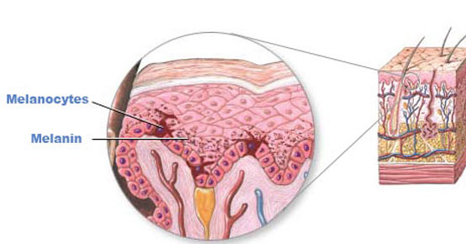
Melanin
Is derivative of tyrosine & is synthesized by melanocytes, residing in the basal layer of epithelium.
Melanocytes are first described in oral epithelium by Becker in 1927.

Slide 10
Phenyl alanine( Phenyl alanine hydroxylase)
Tyrosine (tyrosinase Cu containing)/vitamin C
DOPA
(dihydroxy phenyl alanine)
Dopaquinone
Dihydroxy indole (Polymerization)
Melanin

Slide 11
Keratinocytes actually control the melanocytic growth.
Is synthesized within special structures
called Melanosomes .
It is composed of
Eumelanin- brown black pigment
Pheomelanin - a red-yellow color.

Slide 12
Melanosis means over production of melanin, it might be due to increased sun exposure, physiologic, neoplasia, medication, high adreno-corticotrophic hormone, post inflammatory changes, genetic and autoimmune disease.
If etiology cannot be ascertained tissue biopsy is warranted for definitive diagnosis.

Slide 13
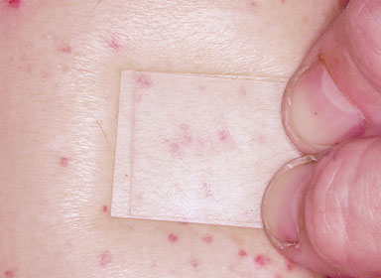
Diascopy
Diascopy: A flat glass plate through which one can examine superficial skin lesions by means of pressure.
a glass or clear plastic plate pressed against the skin for observing changes produced in the underlying skin after the blood vessels are emptied and the skin is blanched.

Slide 14
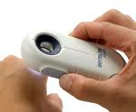
Dermascopy

Slide 15
FOCAL MELANOTIC PIGMENTATIONS

Slide 16
Focal Melanocytic Pigmentation
Freckle/Ephelis
Oral/Labial Melanotic Macule
Oral Melanoacanthoma
Melanocytic Nevus
Malignant Melanoma

Slide 17
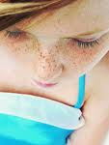
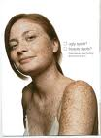
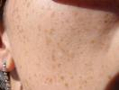
Freckles / Ephelis

Slide 18
EPI – upon HELOS – sun
Increased pigmentation in basal layer
Prominent in summer
commonly occurring asymptomatic small (1-3mm), well- circumscribed, tan or brown colored macule seen on sun exposed regions of facial & perioral skin.

Slide 19
Polymorphisms in the MC1R gene –associated with childhood freckles.
Freckles predisposition gene is associated with chromosome 4q32-q34.
with increasing age freckles decreases
Treatment :
Use of sunscreens to reduce appearance of new freckles

Slide 20
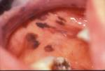
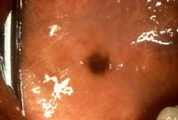
Oral /labial Melanotic Macule / focal melanosis.

Slide 21
Oral Melanotic Macules / focal melanosis.
is a unique, benign pigmented lesion that is not associated with dermal
counterpart.
not known to transform into melanoma.
Trauma plays an important role
Clinical features:
Well-circumscribed, oval or irregular in shape, size is < 1cm.
females > males
usually lower lip and gingiva
Biopsy is required to establish diagnosis.
No treatment is required.
Differential diagnosis
-freckles
- malignant melanoma
- amalgam tattoo
focal ecchymosis
Melanocytic nevus

Slide 22
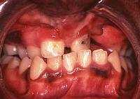
Oral melanoacanthoma / Melanoacanthosis
Is unusual, benign mixed lesion of keratinocytes & pigment laden dentritic melanocytes.
It is rapid in onset. Acute trauma or H/o chronic irritation precedes the development of lesion.
Clinical features:
Black females-3rd -4th decades
Asymptomatic
buccal mucosa
cutaneous type……dermatosis papulosa nigra

Slide 23
Differential diagnosis
- malignant melanoma
- melanotic macule
Treatment
No treatment required, may also undergo spontaneous resolution.

Slide 24
Melanocytic nevus
Definition: Defined as congenital, developmental tumor like malformation of the skin or mucous membrane / superficial lesion composed of nevus cells
-Are benign tumours of melanocytes.
-Intraorally uncommon lesions.
ALLEN AND SPITZ CLASSIFICATION
I. ordinary pigmented nevi
a. Intradermal/ intramucosal nevi
b. Junctional nevi
c. Compound nevus
II. Common blue nevus.
III. Benign juvenile melanoma (spindle and epitheloid nevus)

Slide 25
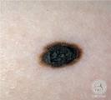
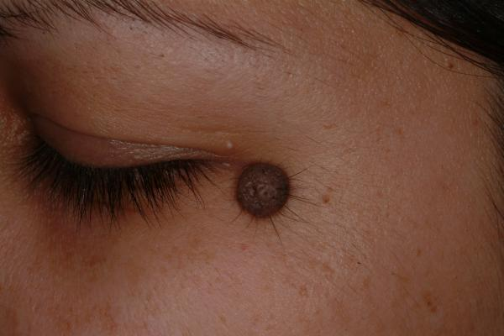
JUNCTIONAL NEVI COMPOUND NEVI.
INTRAMUCOSAL NEVI BLUE NEVI

Slide 26
nevi
Congenital
small
greater than 1 cm
garment
Greater than 10 cm
acquired
Types:

Slide 27
1. congenital and acquired variants
- may be flat, slightly elevated papillary, pedunculated (on stalk) or nodular (dome shaped)
- usually well circumscribed
2. pigmented or amelanotic (non-pigmented)

Slide 28
congenital nevus
a) incidence 1% live births
b) usually larger than acquired nevi (>1.5 cm diameter)
c) considered giant nevus if >20 cm
d) can exhibit hair growth as well as pigmentation
e) malignant transformation 1%, if giant nevus 6-12%
f) excise if possible

Slide 29
Acquired nevi
Acquired nevi are common
Appear at 8th month and increase in no with age

Slide 30
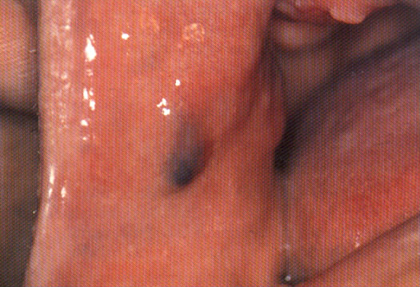
Intradermal / intramucosal nevus
Common on skin or mucosa
Several dozens scattered over body
Smooth elevated above surface
Strands of hair growing on surface
Does not occur on feet ,palm or genitilia
H/P:
nevus cells in Connective tissue
Overlying epithelium separated

Slide 31
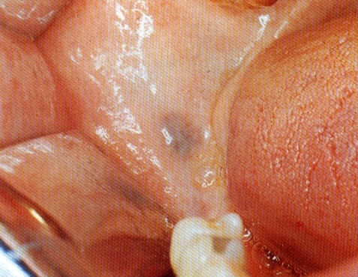
Juctional nevus
Similar to intradermal nevus
Zone of demarcation absent
Cells blend and contact with epithelium
Cells cross over into Connective Tissue called ABTROFUNG or DROPPING OFF EFFECT
PROPENSITY FOR MELANOMAS

Slide 32
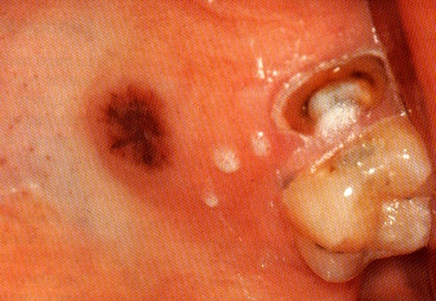
Compound nevus
Composed of both of above
melanocytes begin to proliferate down the connective tissue
Assume a dome shape appearance.
H/P
Nests of nevus cells dropping off from the epidermis
Large nests also present in the dermis

Slide 33
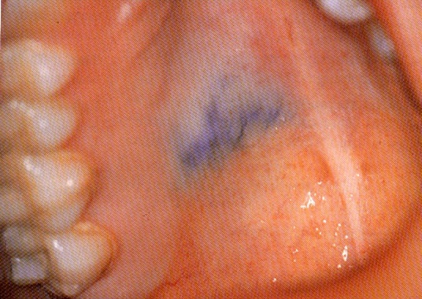
Blue nevus
The blue nevus is blue on the skin because the melanocytic cells reside deep in the connective tissue
The overlying vessels dampen the brown coloration of melanin, yielding a blue tint.

Slide 34
H/P: two types
Common blue nevus
Elongated melanocytes with dendritic process
Oriented parallel to the epidermis in the middle and lower thirds
Cells packed with melanin
Cellular blue nevus
Additional cell type present
Large round cell ,Vacuolated cytoplasm
Cells are arranged in alveolar pattern

Slide 35
Congenital mucosal & cutaneous nevi

Slide 36
nevus of Ota
a) speckled blue-black pigmentation following distribution of trigeminal nerve branches 1 and 2
b) may have synchronous skin and intra-oral lesions
nevus of Ito
a) follows distribution of supraclavicular, scapular and deltoid nerves

Slide 37
epithelioid and spindle cell (Spitz) nevus
a) first reported in 1948 by Spitz as benign juvenile melanoma
b) pink skin nodule
c) clinically resembles pyogenic granuloma
d) most common in children but 25% are reported in patients over age 30

Slide 38
Oral manifestations
Rare in oral cavity
Except for spindle cell nevus
Intramucosal nevi(55%), Blue nevus (36%) compound nevus(6%), junctional nevus(<3%)
Occur at all ages, but common in females
Hard palate, buccal mucosa, lip and gingiva account for majority of cases
Majority are raised 20% are flat , macular

Slide 39
Less frequently occuring -CELLULAR BLUE NEVI.
These are more aggressive & has greater rate of recurrence.
Increased number of nevi are common in Turners s& Noonans syndrome.
Treatment
Laser & intense light therapy are used in cutaneous nevi.

Slide 40
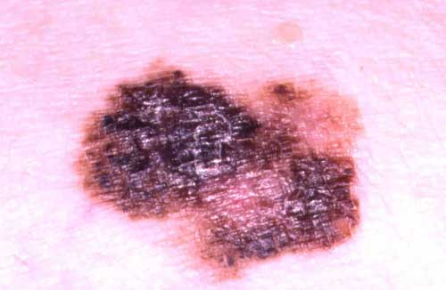
Malignant Melanoma/melanocarcinoma
Etiology & pathogenesis:
least common, but most deadly of all primary skin cancers.
H/o multiple episodes of acute sun exposure, especially at younger age, immunosuppression, presence of multiple cutaneous nevi, & family H/o melanoma are the risk factors.
Melanoma prone families have high incidence of mutations in the tumour suppressor genes ,CDKNA2/p16.
Melanocytic nevi, melanomas frequently exhibit mutations in BRAF, HRAS, NRAS proto-oncogenes.

Slide 41
Clinical features:
Commonly seen on the malar region of the skin.
They are commonly seen in white population.
Cutaneous melanomas appear macular & the color can be varied ranging from brown to blue with zones of depigmentation.
The lesions are commonly seen in elderly population, over the age of 45, shows male predilection.

Slide 42
Clinical characteristics are best described by A B C D E of Melanoma:
A: Asymmetry
B: Border irregularity
C: Color Variation
D: Diameter > 6mm
E: Elevation or surface elevation.

Slide 43
Melanomas tend to exhibit 2 directional patterns of growth
Radial growth pattern
Vertical growth pattern
Radial growth phase :
Present during initial stages ; confined to initial layer of epidermis ; the malignant melanocytes tend to spread laterally ;have good prognosis
Vertical growth phase :
Neoplastic cells populate underlying dermis , metastasis possible ;prognosis is poor

Slide 44
Types of melanoma
There are 4 main clinicopathologic subtypes of melanoma.
Superficial spreading melanoma
Lentigo maligna melanoma
Acral lentiginous melanoma
Nodular melanoma
Radial growth pattern
Vertical growth pattern

Slide 45
Superficial spreading melanoma:
Most common cutaneous form of melanoma -70%
Appears as macules with variety of colors. Lesions are slightly elevated of < 3cm in greatest diameter at diagnosis.
predominant sites
*males: head, neck and trunk
*females: back of legs

Slide 46
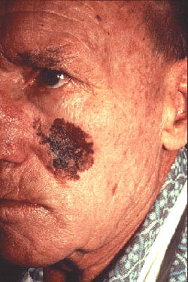
Lentigo maligna melanoma
Accounts for 5-10 % of cutaneous melanomas.
terminology
large size (4-6 cm average diameter)
flat surface

Slide 47
Acral lentiginous melanoma
Most common form of oral melanoma.
Darkly pigmented , irregularly marginated macule, which later develops a nodular growth phase.
essentially an aggressive form of lentigo maligna melanoma

Slide 48
Nodular melanoma
Nodular melanoma of gingiva
Represents 15% of cutaneous melanomas & 1/3 rd develops in head & neck region.
It is actually a deeply pigmented exophytic lesion, sometimes melanoma cells are so poorly differentiated that they no longer produce melanin, resulting in non-pigmented amelanotic melanoma.

Slide 49
Ulcerations, pain, tooth mobility, spontaneous exfoliation, root resorption, bone loss, parasthesia are present or may be asymptomatic.
Have very poor prognosis as frequently associated with regional lymphatic metastasis.
H/o previous melanoma, sparing of palate & gingiva, amelanosis, lack of junctional activity are suggestive of metastatic one.
Treatment
Surgery with wide margins is treatment of choice.
CT & MRI to metastases to the regional lymph nodes.
Immunotheraupetic agents like interferon alpha 2B.

Slide 50
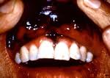
Clinical features: Oral melanomas
Comprise less than 1% of all melanomas.
Twice as common in men than women
Occur on the anterior labial gingiva and the anterior aspect of the hard palate.
In the early stages, macular brown and black plaques with an irregular outline
Eventually become more diffuse, nodular, and tumefactive, with foci of hyper- and hypopigmentation.
Upto 1/3rd may exhibit little or no pigmentation (amelanosis).

Slide 51
Treatment :
Excision with wide margins is the treatment of choice
Once nodularity is evolved, the lesion is probly already metastasized
Chemotherapy and immunotherapy strategies undertaken once the metastasis has been identified

Slide 52
Multifocal/diffuse pigmentation

Slide 53
Multifocal/Diffuse Pigmentation
Physiologic Pigmentation
Drug-Induced Melanosis
Smoker’s Melanosis
Post-inflammatory (Inflammatory) Hyperpigmentation
Melasma (Chloasma)

Slide 54
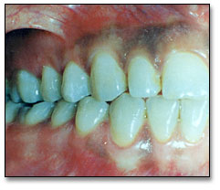
Physiological (Racial) Pigmentation:
Most common source of diffused pigmentation. Common in African, Asian & Mediterranean populations.
Develops during the first 2 decades of life but may not come to patient’s notice until later.

Slide 55
Drug-Induced Pigmentation
Clinical features:
10-20% of all acquired melanocytic pigmentations are drug induced.
Can be diffused or localised to one mucosal surface often seen on hard palate .
Diagnosis:
Onset of melanosis is temporary & associated with specific medications

Slide 56
Drugs associated with oral mucosal pigmentation
Antimalarials: Chloroquine, Hydroxychloroquine
Quinidine,
Zidovudine,
Tetracycline,
Minocycline,
Chlorpromazine, Oral contraceptives,
Clofazimine,
Ketoconazole,
Amiodarone,
Busulphan,
Doxorubicin,
Bleomycin,
Cyclophosphamide,
5-Flurouracil

Slide 57
Minocycline –induced oral melanosis
Is a tetracycline derivative used for acne treatment.
Can cause pigmentation of developing teeth,
On chronic intake may get incorporated into normal bone thus the teeth may appear normal but their surrounding bone may appear green blue or even black.
Investigation- Prussian blue.
Methacycline-similar pigmentation

Slide 58
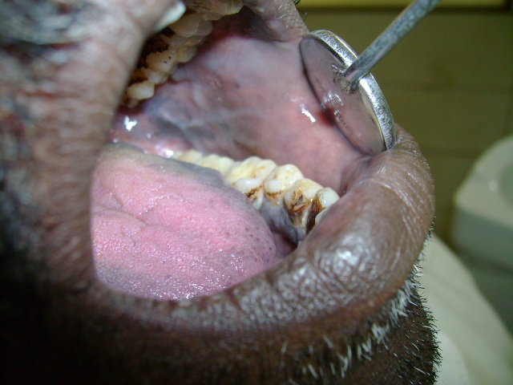
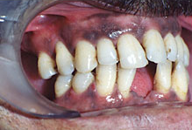
Smoker’s Melanosis
Oral melanosis increases prominently during the first year of smoking.
Increased production of melanin is a biologic defense against noxious products of tobacco smoke .
Occurs in 2-5% of the smokers ; intensity related to duration of smoking .
Commonly involve ant. Labial gingiva and palate.
Smoker’s melanosis usually disappears within 3 years of smoking cessation

Slide 59
Alcohol also induces pigmentation particularly the posterior regions of the mouth along with soft palate
Alcoholic melanosis is associated with higher risk of cancers of upper aero-digestive tract.

Slide 60
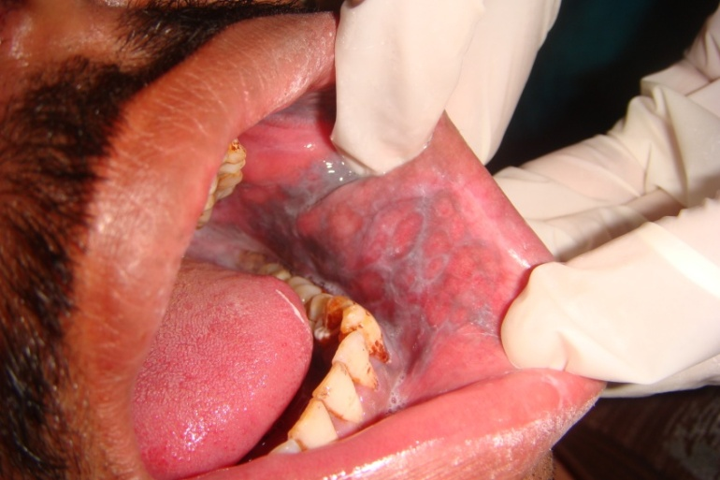
Post inflammatory Pigmentation
Frequently seen in dark-skinned individuals.
Occurs in the areas subjected to previous injury / inflammation.
Eg:, In oral cavity lichen planus.
Multiple brown to black pigmented area are seen adjacent to erosive or reticular lichen planus
lichen planus pigmentosus.
Upon resolution of lichenoid lesion pigmentation may or may not resolve.

Slide 61
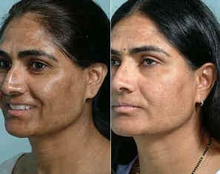
Melasma (chloasma) / mask of pregnancy.
Melasma is often used to describe pigmentation associated with pregnancy or ingestion of oral contraceptives.(both are associated with oral mucosal melanosis)
Combination of estrogen & progesterone induces the pigment.
Seen in sun exposed areas ,forehead,cheeks,upper lips,chin
Gradually resolves after pregnancy or discontinuation of oral contraceptives.

Slide 63
Melanosis associated with systemic or genetic diseases

Slide 64
Melanosis Associated With Systemic Or Genetic Disease
Hypoadrenocorticism (Adrenal Insufficiency, Addison’s Disease)
Cushing’s Syndrome/Cushing’s Disease
Hyperthyroidism (Graves’ Disease)
Primary Biliary Cirrhosis
Vitamin B12 (Cobalamin) Deficiency
Peutz-Jegher’s Syndrome
Café au Lait Pigmentation
HIV/AIDS-Associated Melanosis

Slide 65
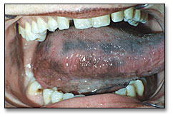
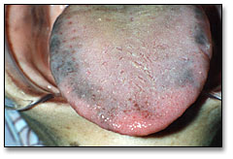
Addison’s disease (Primary hypoadrenalism, Adrenal insufficieny)
Etiology & pathogenesis:
Mucocutaneous hyperpigmentation is the first sign of the disease.
Generalized bronzing and diffuse but patchy melanosis of the oral mucosa are the hallmarks of Adrenal deficiency

Slide 66
Destruction or damage of the adrenal glands
Loss of glucocorticoid production i.e. decrease in endogenous corticosteroid levels.
Caused by
- Autoimmune problems
- Tuberculosis
- Leukemic infiltrates
- Tumor metastases
-trauma to adrenal glands

Slide 67
Failure of the feedback mechanism
Increased (ACTH) and (MSH) from the hypophysis
Stimulation of melanin formation
Lines of brown color changes
Diffuse hyper-pigmentations of the skin ("bronzed disease")
Prefers light-exposed and mechanically stressed regions
Flat melanin pigmentations on the oral mucosa: initial change
predominant localizations on the cheek mucosa and dorsum of the tongue

Slide 68
Diagnosis:
Oral biopsy shows increased melanin in the basal cell layer .
Serum cortisol & electrolyte are necessary tests.
Low serum cortisol < 20 µg/dl/1hr.
Hyponatremia & hyperkalemia are associated with adrenal insufficiency.
Treatment:
Treatment of the underlying cause and corticosteroid replacement therapy.

Slide 69
Cushing’s syndrome/ Cushing's disease:
Adrenocortical hyperactivity due to cortical hyperplasia
Hypercorticism may be due to pituitary ACTH secreting tumor that secondarily induces an adrenal hyper secretion
Hypertensive and hyper glycemic and may show facial edema (“moon face”).
“Moon face”- fullness of the cheeks and temporal fat pads.
“Buffalo Hump”- fat accumulation in the temporal, supra-clavicular and dorso-cervical areas.
“A Lemon on sticks”- increase abdominal fat and muscle wasting in tha arms and legs.

Slide 70
Hyperthyroidism / Graves disease
Melanosis is the consequence of hyperthyroidism especially in dark skinned individuals.
Resolves after treatment of thyroid abnormality.

Slide 71
Primary biliary cirrhosis:
Uncommon disease & unknown etiology.
Middle aged women are affected.
The disease results from damage to small intrahepatic bile ducts.
It is a source of generalized non melanocytic muco-cutaneous discoloration.
jaundice is end stage complication of this disease.
Yellow discoloration of the skin, eyes and mucous membrane.
Management.– removal of underline cause
D/D------Carotenemia (B carotene& lycopenemia excess lycopene found in tomatoes, fruits, etc…)

Slide 72
Vit- B12 deficiency:
Has systemic manifestations
Diffuse mucocutaneous pigmentation(very rare)
Unknown mechanism

Slide 73
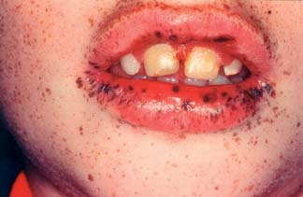
Peutz-Jeghers Syndrome
Autosomal dominant genetic disorder associated with mutation of STK11/LKB1 tumor suppressor gene.
Associated with intestinal polyposis, cancer susceptibly, multiple pigmented macules of lips, perioral skin, hands & feet.
Resembles freckles usually measuring < 0.5 cm in diameter.
Similar lesions may appear on tongue & buccal & labial mucosa.
Cowden syndrome, Cronkhite -Canada syndrome have similar features.

Slide 74
Café au lait pigmentation:
Macules are discrete melanin pigmented patches of skin having irregular margins & are brown color.
Giant melanosome = macromelanosome
Fanconi’s anemia
Mc Cune Albright syndrome
Neurofibromatosis type 1&2
Leopards syndrome
Noonan’s syndrome
Tuberous sclerosis
Russell silver syndrome
Cherubism
Mazabraud’s disease
Addisons disease
Cushings syndrome

Slide 75
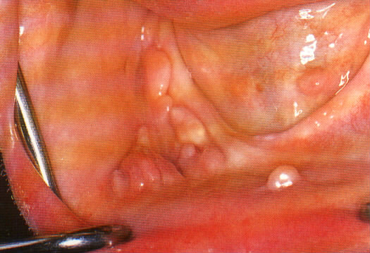
Six or more large macules (> 1.5cm in diameter) should be suspected in neurofibrmatosis.
Two types
-Neurofibomatosis 1 (Von reckling hausen’s disease ) -Neurofibomatosis 2 (acoustic neurofibroma )
Oral pigmentations are rare ,cutaneous manifestation are predominant
Café au lait macules associated with Albright syndrome (polyostotic fibrous dysplasia , endocrine dysfunction , precocious puberty , café-au-lait macules )
Borders in Mc Cune Albright’s syndrome have irregular outline where as smooth in neurofibromatosis.

Slide 76
Differential diagnosis :
Peutz- Jegher's syndrome
Addison’s disease
Management :
Neurofibromatosis :
Café au lait macules associated with it does not require any treatment
Facial neuromas should be excised for cosmetic purpose.

Slide 77
HIV/AIDS melanosis
Diffuse Pigmentation - intake of various drugs antifungal, antiretroviral like zidovudine, or as a result of adrenocortical destruction by virulent infectious organisms.
Immune dysregulation associated with HIV - increased secretion Melanocyte Stimulating Hormone from the anterior pitutary.
Buccal mucosa is most common site, but gingiva, palate , tongue are also involved.
May be progressive hyperpigmentation of the skin, nails, mucous membranes.
Recent study shows that melanosis may be an actual potentially late stage clinical manifestation of HIV/AIDS.
Gold stein & co show the correlation between mucocutaneous pigment & CD4 count < 200cells/µl

Slide 78
BLUE/PURPLE VASCULAR LESIONS

Slide 79
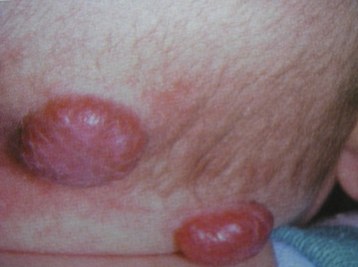
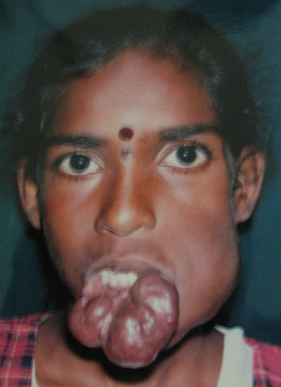
Hemangiomas
The hemangiomas are found on the skin, in the scalp, and within the connective tissue of mucous membranes
Approximately 85% of childhood-onset hemangiomas spontaneously regress after puberty.
Depending on the depth of the vascular proliferation, the lesion may harbor vessels close to the overlying epithelium and appear reddish blue or, if a little deeper in the connective tissue, a deep blue.

Slide 80
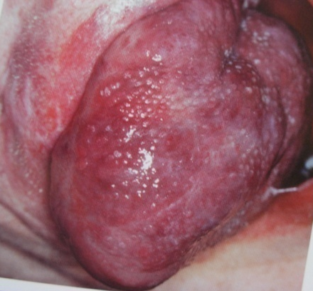
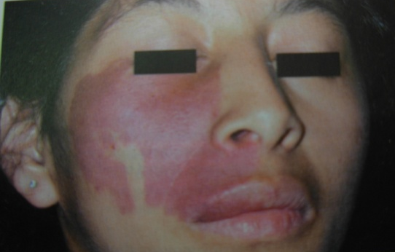
When occurring within muscle (so-called intramuscular hemangiomas) may fail to show any surface discoloration.
Most hemangiomas are raised and nodular, some may be flat, macular, and diffuse, particularly on the facial skin, where they are referred to as port-wine stains
Most oral hemangiomas are located on the tongue, where they are multinodular and bluish red.

Slide 81
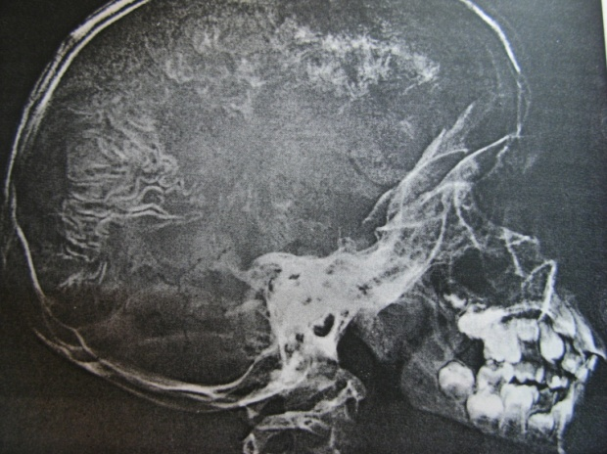
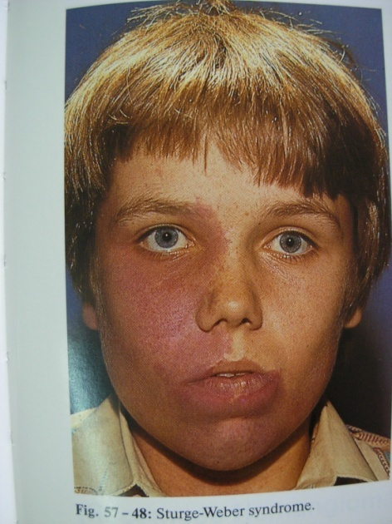
Tongue angiomas frequently extend deeply between the intrinsic muscles of the tongue
The lip mucosa is another common site for hemangiomas are usually localized, blue, and raised.
Port-wine stain involves the facial skin and is flat and magenta in color.
Vascular lesions occurs in the brain as well as on the facial skin
Skull radiography may disclose vessel wall calcifications as “tram line” calcifications.

Slide 82
Most ,patent vascular lesions will blanch under pressure
That is diascopy,and pulsations
Dermascopy: employed for melanocytic lesions
Specially for labial and anterior and lingual pigmentation.
It is performed using incident light and oil immersion. Handheld with surface microscope.

Slide 83
It should be differentiated from hematomas, mucocele, superficial cysts, varix, aneurysms
Treatment
Conventional surgery, laser surgery, or cryosurgery.
Larger lesions that extend into muscles are more difficult to eradicate surgically, and intralesional injection of sclerosing agents such as 1% sodium tetradecyl sulfate
Cutaneous port-wine stains can be treated by subcutaneous tattooing or by argon laser

Slide 84
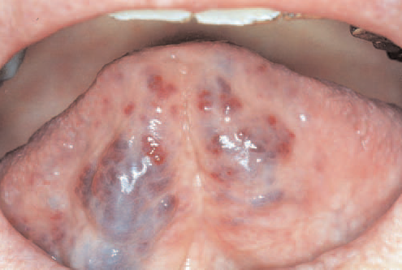
Varicosity
A varicosity is distended vein it is common in oral cavity especially in older individuals
Clinical Features
Appears as superficial painless ,bluish lesions , some what congested and accentuates the shape and distribution of the vessels
Frequent site is ventral surface of tongue and lower lip , when sublingual veins are involved are called caviar tongue

Slide 85
Differential diagnosis :
Hemangioma ,Aneurysm, Mucocele, Ranula
Management :
Generally no treatment is required, a positive diagnosis is all that necessary
If the lesion relates to cardiovascular condition dental treatment should be differed until patient’s physician indicates it is safe to proceed.

Slide 86
Kaposi’s sarcoma
A multifocal vascular malignancy seen predominantly in HIV-infected patients.
HHV-8 is the cause.
commonly affects the hard palate, gingiva and tongue.
Early lesions appear as flat or slightly elevated brown to purple lesions that are often bilateral.
Advanced lesions appear as dark red to purple plaques or nodules that may exhibit ulceration, bleeding and necrosis.

Slide 87
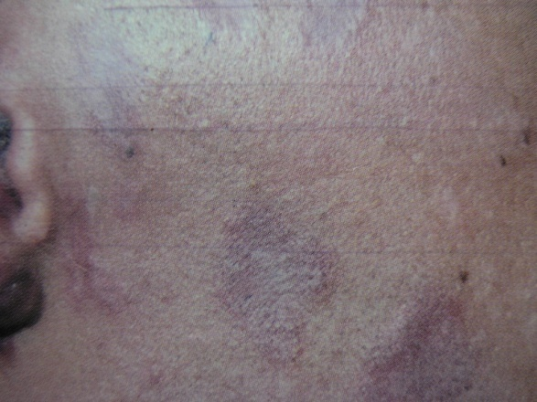
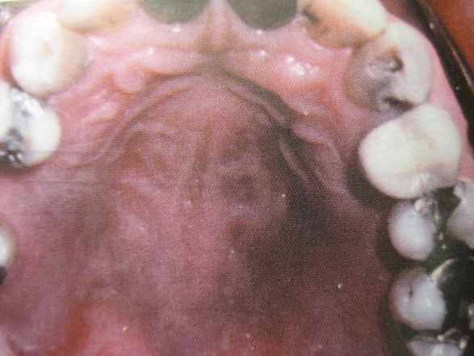
AIDS related Kaposi’s sarcoma :
Develop in 40 % of the patient with AIDS as an early sign of disease
Occurs in many cutaneous locations along the lines of clevage and tip of the nose
Oral lesions present as initial site of involvement in 25% of cases

Slide 88
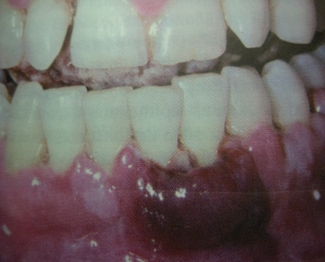
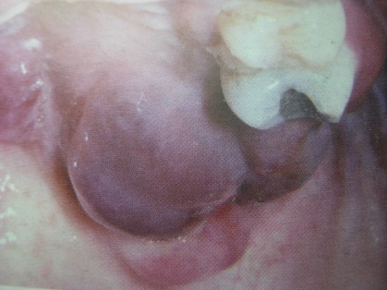
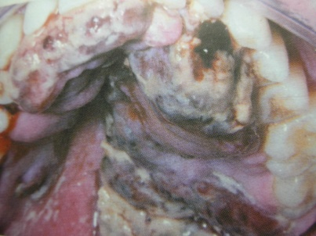
Strong predilection for palatal and gingival mucosa
Treatment and prognosis :
Depends on stage of the disease and the clinical subtypes
Radiation therapy especially electron beam radiotherapy is given

Slide 89
Hereditary hemorrhagic telangectasia
Rendu osler Weber syndrome ,hereditary familial angiomatosis
Triad of telangectasia , recurrent epistaxis , positive family history of the disease
Some times associated with multiorgan arteio-venous malformation
Etiopathogenesis :
Autosomal dominant

Slide 90
Clinical features :
Present at birth.
Appear to increase in number and prominence as the patients ages
Most common on face .
May present with recurrent episodes of epistaxis

Slide 91
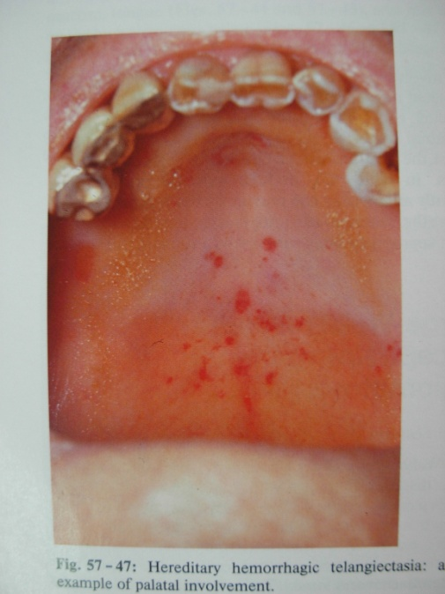
Numerous red papules present on oropharengeal nasal mucosa, which blanches when diascopy is performed
Telangectiasis vessels are most frequently seen in vermillion zone of lips , tongue and buccal mucosa

Slide 92
Treatment :
For mild cases - no treatment is required
Moderete cases - selective cryosurgery or electrosurgery.
Involved nasal mucosa are treated by septal dermoplasty or skin grafting
Prognosis is good

Slide 93
BROWN HEME ASSOCIATED
LESIONS

Slide 94
Hemoglobin and Iron-associated Pigmentation
Ecchymosis
Purpura/Petechiae
Hemochromatosis

Slide 95
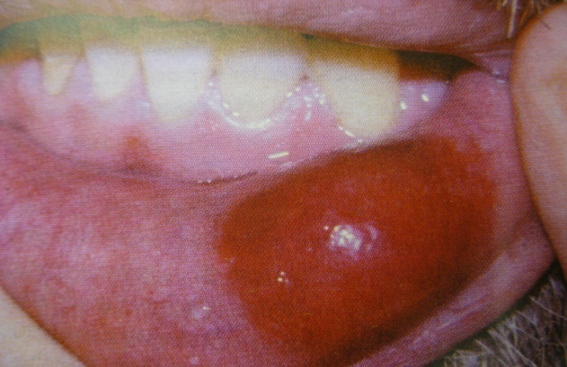
Ecchymosis
Traumatic ecchymosis is common on lips & face.
Bright red macule or as a swelling if a hematoma forms. The lesion is brown with in a few days, after hemoglobin is degraded to hemosiderin
Common with patients on anticoagulants, liver cirrhosis, leukemia, end stage renal disease, hereditary coagulopathic disorders.
Investigations: PTT, CT, BT,INR

Slide 96
Purpura / Petechiae
These appears red initially & turn brown in few days once the extravasated red cells have lysed & have been degraded to hemosiderin.
These may develop due to trauma or viral or systemic diseases.

Slide 97
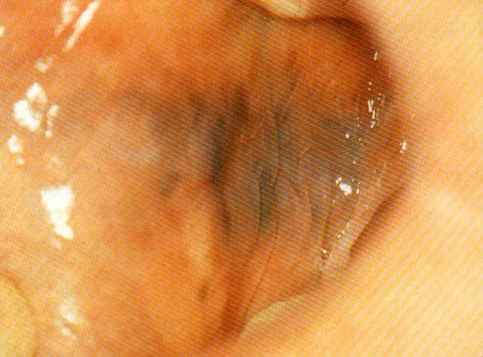
Hemochromatosis
Also called as BRONZE DIABETES
Bronze diabetes is a condition in which excess iron deposits in the body results in eventual sclerosis and dysfunction of involved tissue and organ.
The iron is stored in the form of hemosiderin and ferretin
The contributing factors are
Idiopathic
Diet
hereditary.
Excessive blood transfusion

Slide 98
Complications: liver cirrhosis, diabetes, anemia, heart failure, hypertension, cancer and bronzing of skin(90%).
oral pigmentation most commonly effects palate and gingiva and is diffuse & brown – grey in appearance.
Investigation: Prussian blue staining.

Slide 99
Exogenous Pigmentation

Slide 100
Exogenous Pigmentation
Amalgam Tattoo
Graphite Tattoos
Ornamental Tattoos
Medicinal Metal-Induced Pigmentation
Heavy-Metal Pigmentation
Drug-Induced Pigmentation
Hairy Tongue

Slide 101
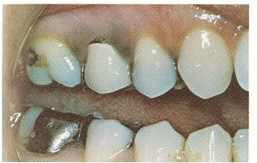
Amalgam Tattoo / Focal argyrosis
Most common source of focal pigmentation in the oral mucosa seen in the vicinity of teeth with amalgam restorations.
Lesions are typically small, asymptomatic macular & bluish gray or black in color seen on the buccal mucosa, gingiva or the palate.

Slide 102
When amalgam particles are large, can be seen in intraoral radiographs as fine radiopaque granules.
Differential diagnosis:
-Melanotic macule
-nevus
-melanoma

Slide 103
GRAPHITE TATTOOS
Accidental injury with a graphite pencil.
Common site: Anterior palate of young children.
Appears as irregular gray to black macule.
biopsy should be performed to exclude the possibility of melanoma.

Slide 104
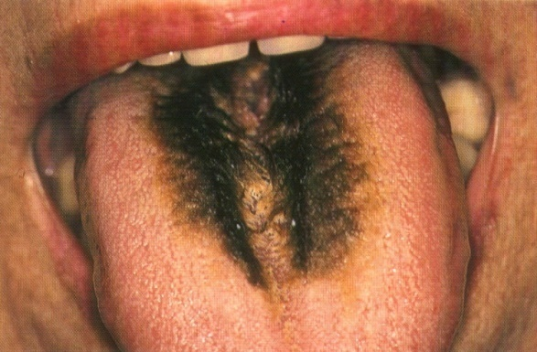
Hairy tongue
A relatively common condition of unknown etiology.
Involves the dorsum, particularly the middle and posterior one-third.
The papillae are elongated, sometimes markedly so, and have the appearance of hairs.
The hyperplastic papillae then become pigmented by the colonization of chromogenic bacteria, which can impart a variety of colors ranging from green to brown to black
Various foods, particularly coffee and tea, probably contribute to the diffuse coloration.

Slide 105
Medicinal metal induced.
Silver- blue gray -Argyria
Gold (rheumatoid arthritis) - blue gray/ purple- Chrysiasis. Oral lichenoid eruptions.
Topical
Silver nitrate- recurrent apthous stomatitis.
Zinc oxide- sun bloc creams.
-Grey black focal pigmentation.
Bismuth subsalicylate tablet(Antacid)- black pigmentation of tongue

Slide 106
AURIC STOMATITIS (chrysiasis)
GOLD SALTS ARE USED IN THE TREATMENT
Rheumatoid arthritis
Lupus erytematosus
Leprosy
Other dermatologic lesions
Purpura and malignant neutropenia
Vesiculation and ulcerations.
Dermatitis and stomatitis.
TREATMENT
Discontinue the drug
Mild alkaline mouth wash

Slide 107
Silver poisoning (argyria)
Permanent discoloration of skin and mucous membrane resulting from local or systemic absorption of silver components
Bluish grey pigmentation is seen
Skin is slate grey , violet or cyanotic

Slide 108
Heavy metal pigmentation
Lead, mercury, bismuth & arsenic poisoning .
These ingested metal salts tend to extravasate from vessels in areas of chronic inflammation.
Marginal gingiva
Grey to black appearance
Oral pigmentation is the 1st sign of heavy metal toxicity
bismuth
lead

Slide 109
MERCURALISM
Potential occupational hazards for dentists and dental team mostly arising from improper use of amalgam alloy
MECHANISM OF ACTION
Short chain alkyl and methyl mercury penetrate the erythrocyte membrane and bind to hemoglobin
ORAL MANIFESTATIONS
Flow of ropy viscid saliva
Hot mouth, burning sensation, metallic taste
Diffuse greyish pigmentation in the form of a line/band along the alveolar mucosa

Slide 110
LEAD POISONING (PLUMBISM)
Caused by lead from exhausts, paints glazed cooking vessels, ointments, batteries.
lead is taken up by circulating erythrocytes and bound to reactive sulfhydryl group of proteins and transmitted to soft tissues
Metallic taste, excessive salivation and dysphasia are oral symptoms
A lead line (grey black) is present along gingival margin

Slide 111
Vitiligo
Common, acquired, autoimmune disease that is associated with hypomelanosis.
0.5-2% in general population.
Is due to destruction of melanocytes.
Genetic and environmental.
Recent study show the gene responsible for vitiligo is also associated with susceptibilty to other autoimmune diseases including diabetes type 1, SLE, & rheumatoid arthritis.
Clinical features:
vitiligo universalis- skin and hair.
Lesions are well circumscribed , round/oval, elongated pale or white color macules that may coalesce into larger areas of diffused depigmentations.

Slide 112
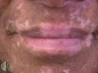
May occur at any age but most of them develop signs at 3rd decade.
No sex prediction.
In patient undergoing immunotherapy for the treatment of malignant melanoma.
rarely affects intra oral mucosal tissues, but upto in 20% patient. inner & outer surface of lips & perioral skin is involved.

Slide 113
Treatment:
Topical steroids, systemic photo-chemotherapies (PUVA) are non surgical procedures.
Depigmentations medicinal therapy.
Surgical intervention for esthetic results in lips.
Autologous epithelial grafts, punch grafting
Micro pigmentation

Slide 114
Management of mucocutaneous melanosis
Focal pigmentation- removal
Drug induced- withdrawal of drug
Topical -Bleaching creams, azelaic acid, hydroquinone, retinoic acid, flucinonide acenonide.
Cryotherapy
Laser therapy- super-pulsed Co2,Q switched Nd YAG.
Phototherapy – Intensed pulsed light and fractional photo thermolysis.

Slide 115
Conclusion....
Pigmentation of the oral mucosa gives a clue to the etiology & as well as diagnosis of disease, hence a complete understanding of the nature of the pigmented lesions is of outmost importance to avoid life threatening conditions.
A thorough history, clinical features, laboratory studies & biopsy aids in arriving at a definitive diagnosis and appropriate treatment planning.

Slide 116
THANK YOU

